Slide 1
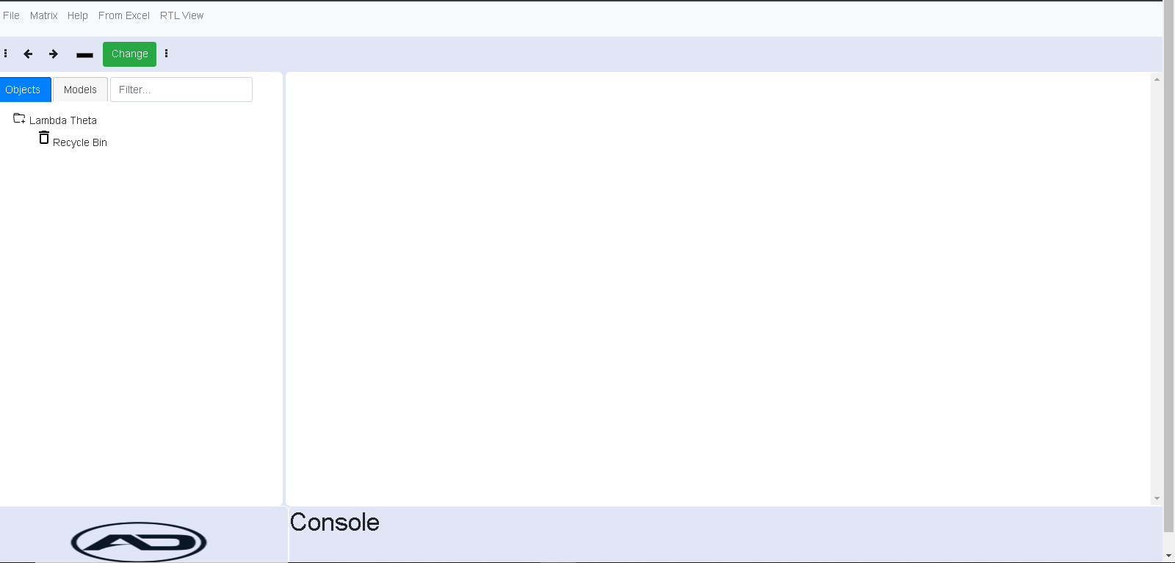
Various buttons for edit, export, delete etc.
Click to create new tab
Right click should allow rename, delete a tab
Organization Portal
Tab1
Tab3
Tab4
Tab5
+
Tab1
Tab2
Chart Name
Chart Name
Chart Name
+
Chart Name
Chart Name
Chart Name
- Drag drop to any other cell
- Delete a graph
- Maximize a graph
Add Button to add a graph
- Export a graph as png/ jpg

